Slide 1
Unmanaged Save Scenario

Slide 2
Use Case

Slide 3
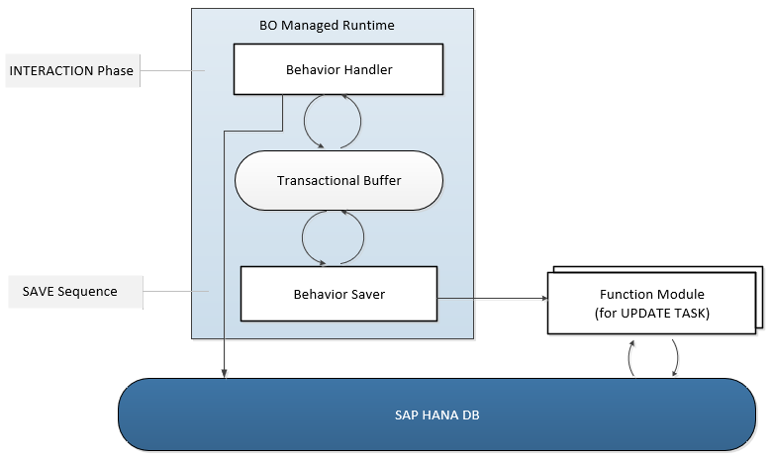
Runtime for the Managed Business Objects with Unmanaged Save

Slide 4
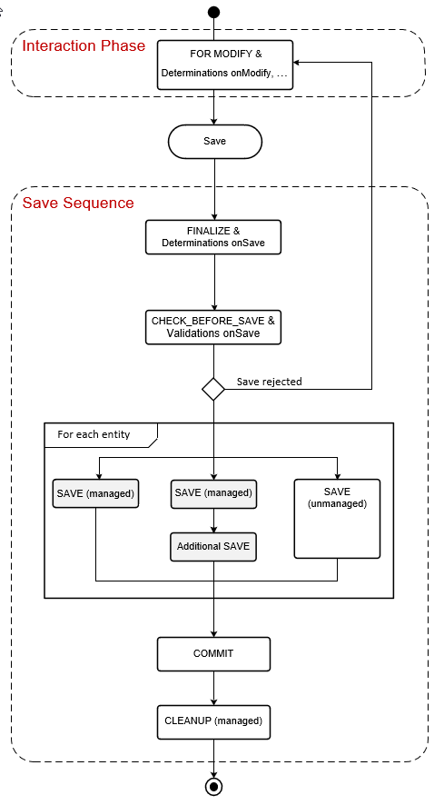
Unmanaged Save within the Transactional Processing

Slide 5
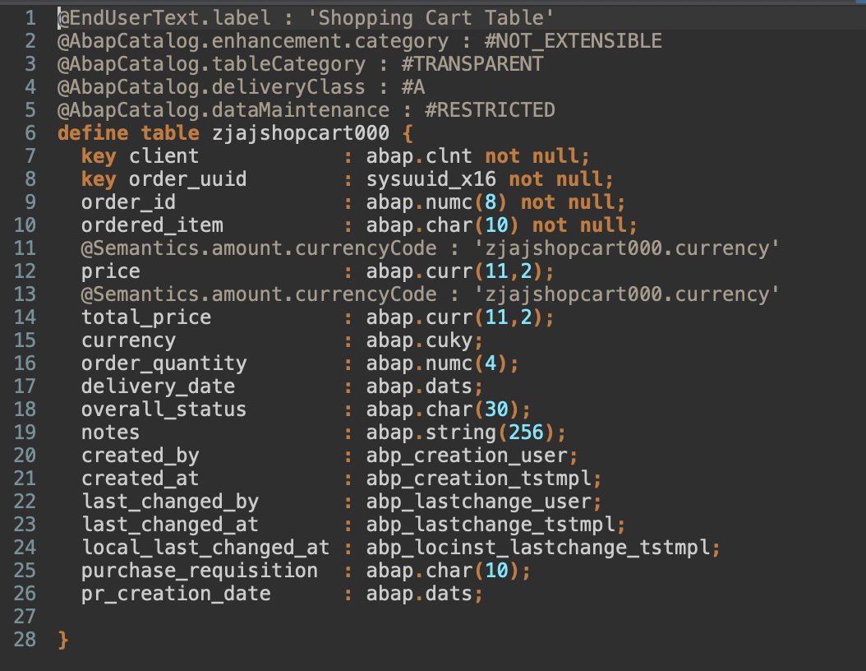
Create Table

Slide 6
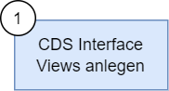
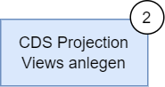
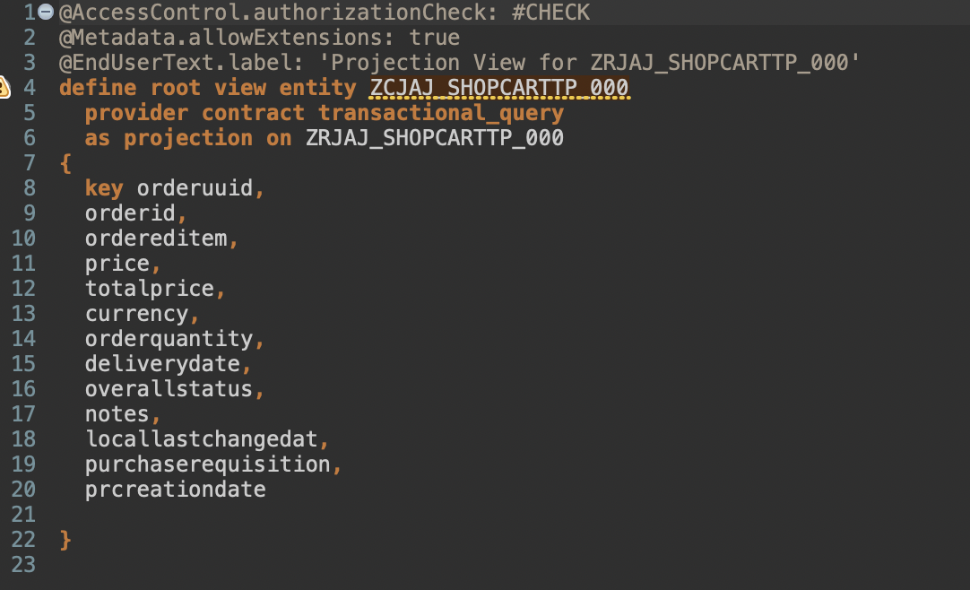
Create CDS View
Create CDS Projection View
Nothing changes in the definition of the CDS views

Slide 7
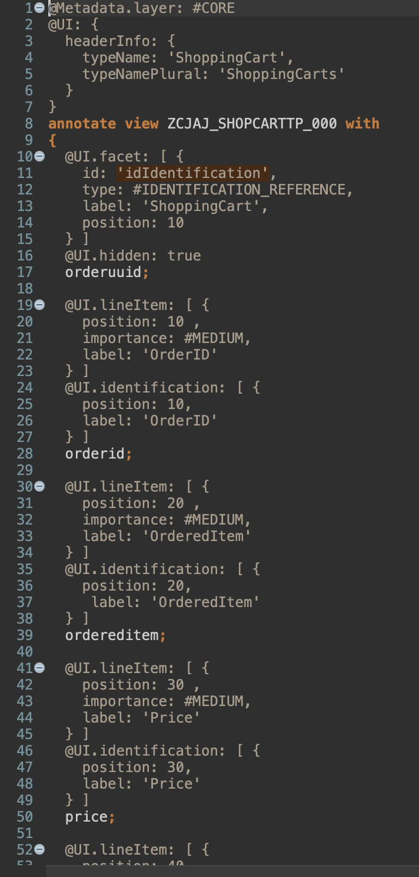
Create Metadata Defintion
Metadata is separated out.
More overview in the view.
View must allow the metadata extension via annotation @Metadata.allowExtensions: true

Slide 8
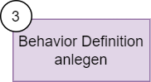
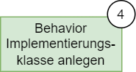
Create Behavior Definition
Create Behavior Class
Create the managed behaviour definition by right-clicking on the view object.
Managed
It is best practice to use strict(2) for strict syntax check. Only strict in old systems.
With draft / use draft
With own draft table (generate it)
Define the field assignment between the DB table and the CDS view.
Create the behaviour class automatically via quick help

Slide 9
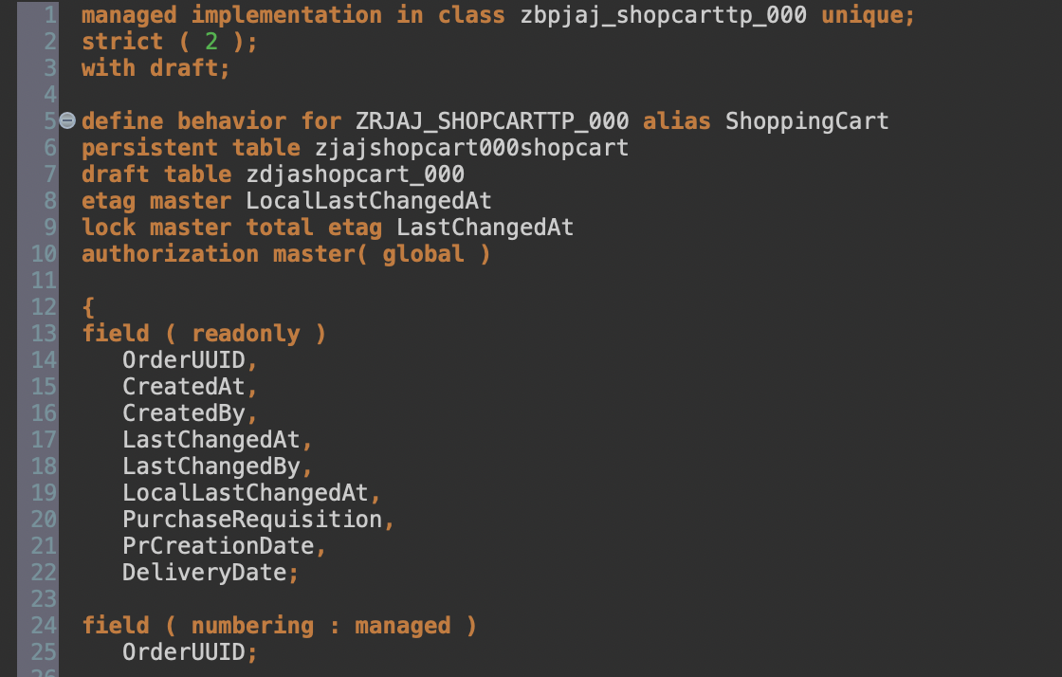
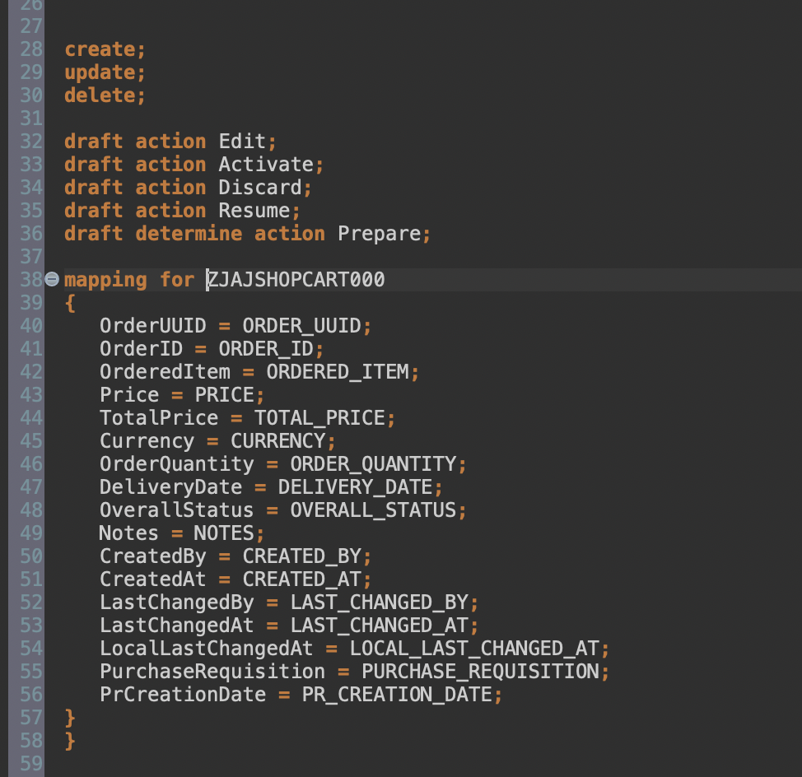

Slide 10
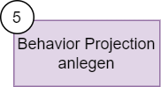
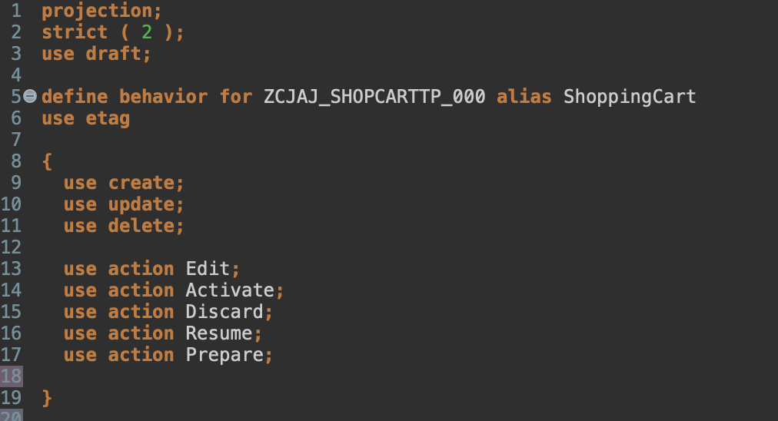
Create Behavior Projection
Specify operations

Slide 11
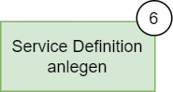
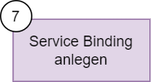
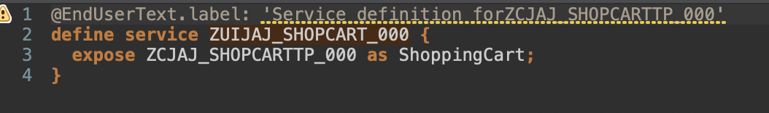
Create Service Defintion
Create Service Bindung
Create service definition and binding (ODATA V4)

Slide 12
Enhance behavior definition of data model
Add the following statements to your behavior definition.
update ( features : instance );
draft action ( features : instance ) Edit;
draft determine action Prepare { validation checkOrderedQuantity; validation checkDeliveryDate; }
determination setInitialOrderValues on modify { create; }
determination calculateTotalPrice on modify { create; field Price; }
validation checkOrderedQuantity on save { create; field OrderQuantity; }
validation checkDeliveryDate on save { create; field DeliveryDate; }

Slide 13
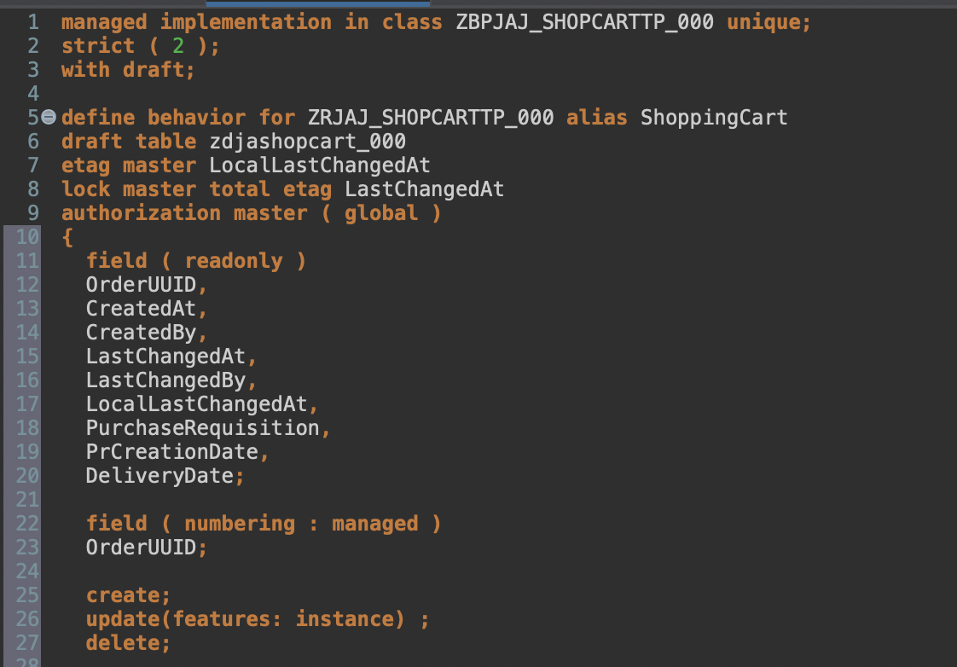
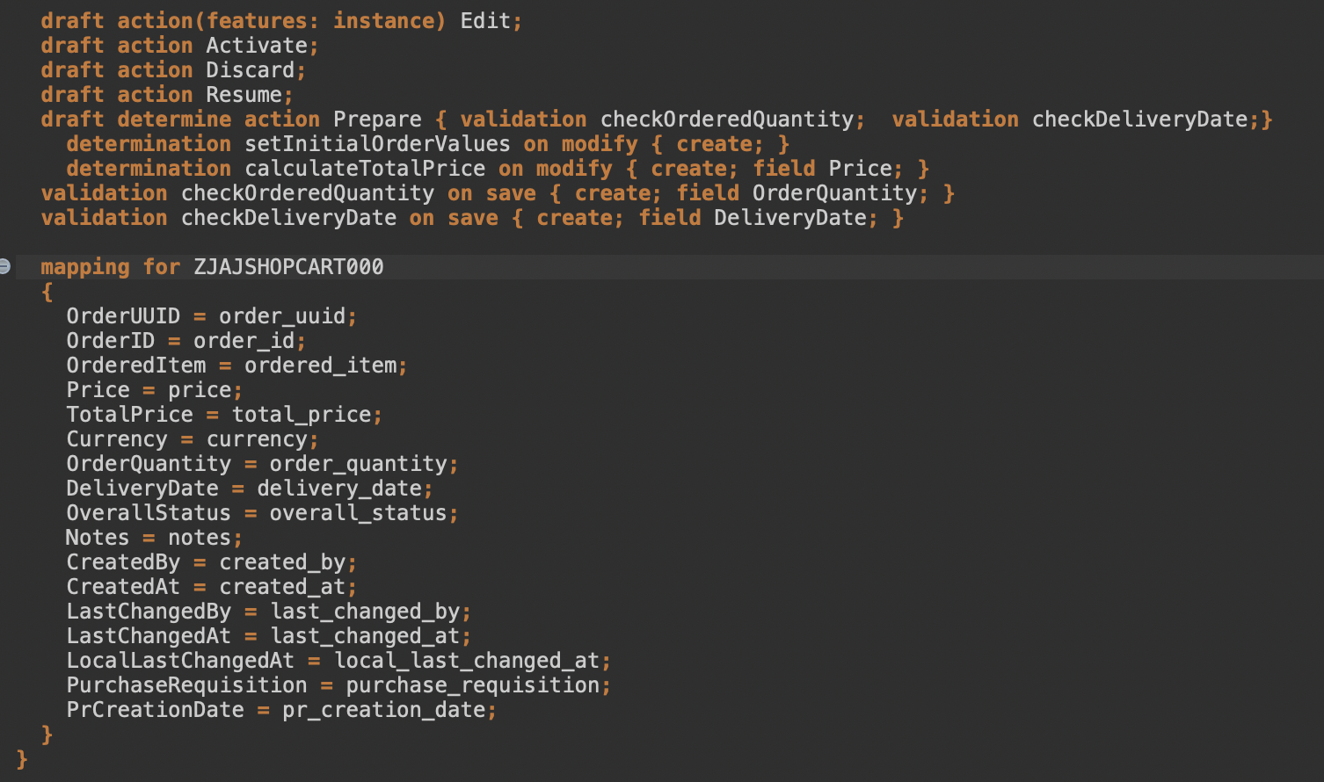

Slide 14
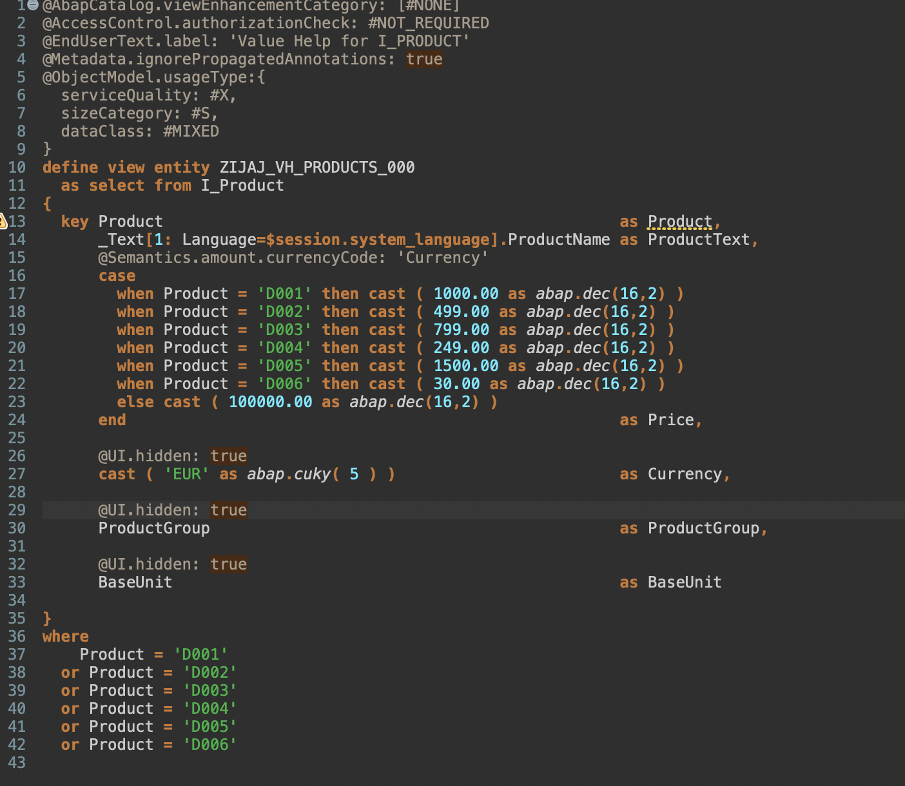
Create Value Help definition for products

Slide 15
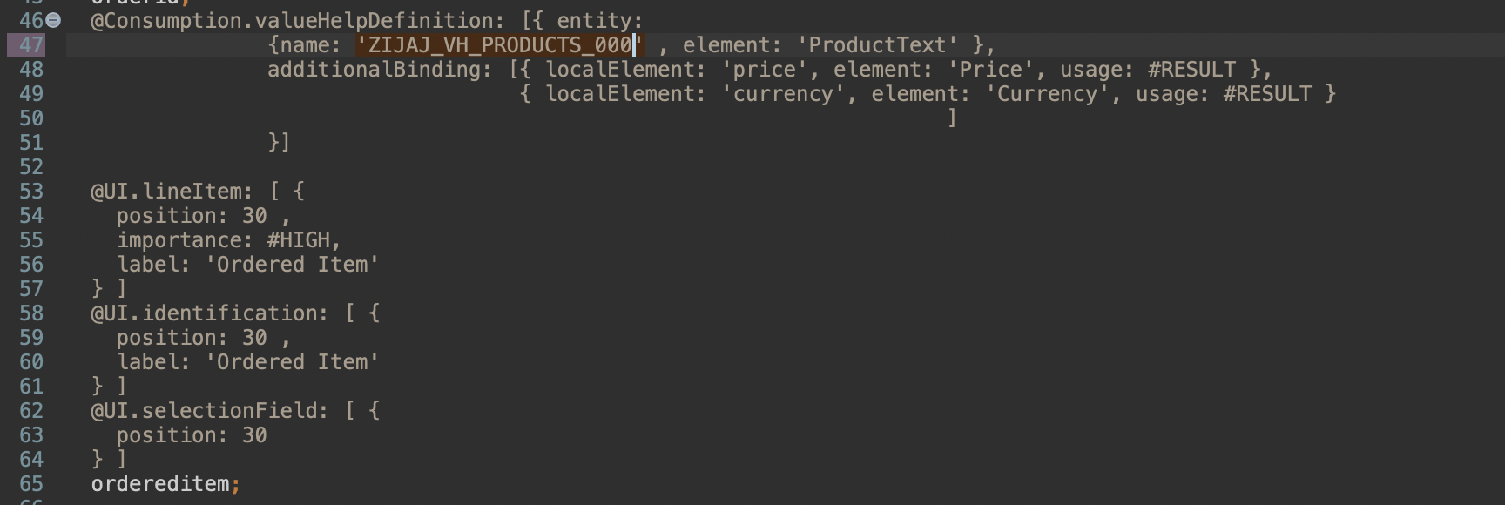
Create Value Help

Slide 16
Create Value Help

Slide 17
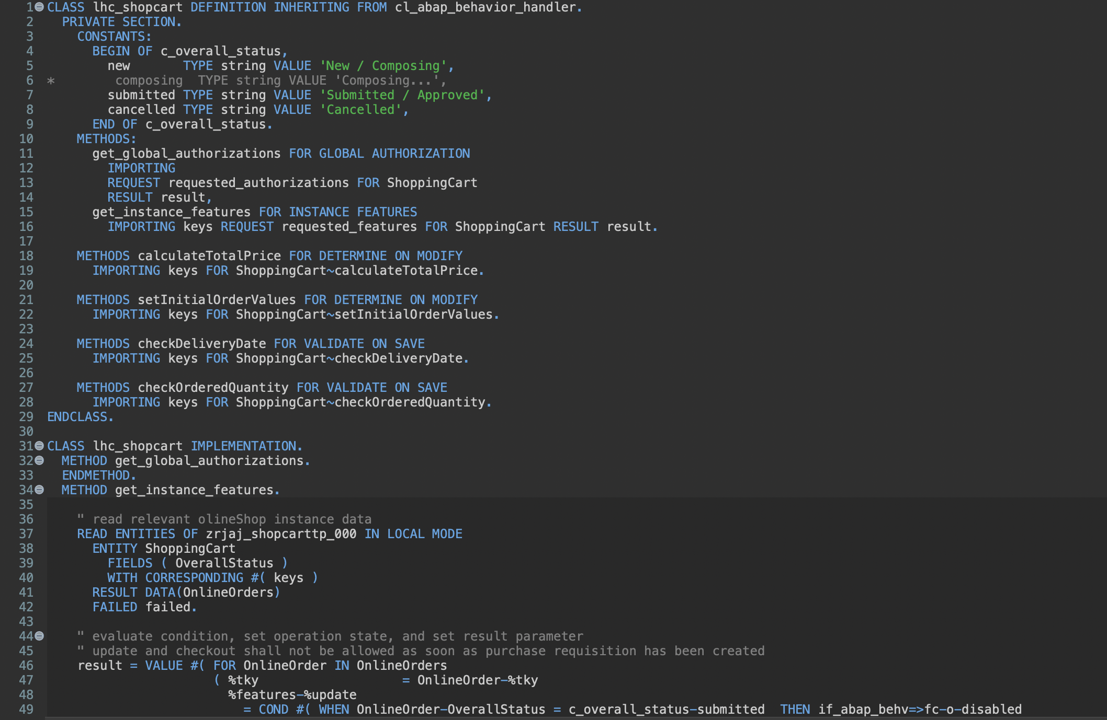
Enhance Behavior Implementation

Slide 18
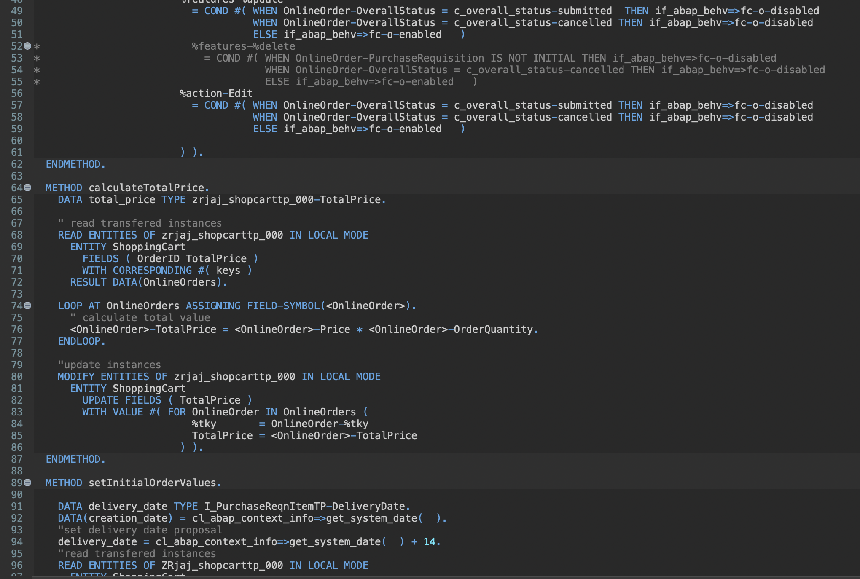
Enhance Behavior Implementation

Slide 19
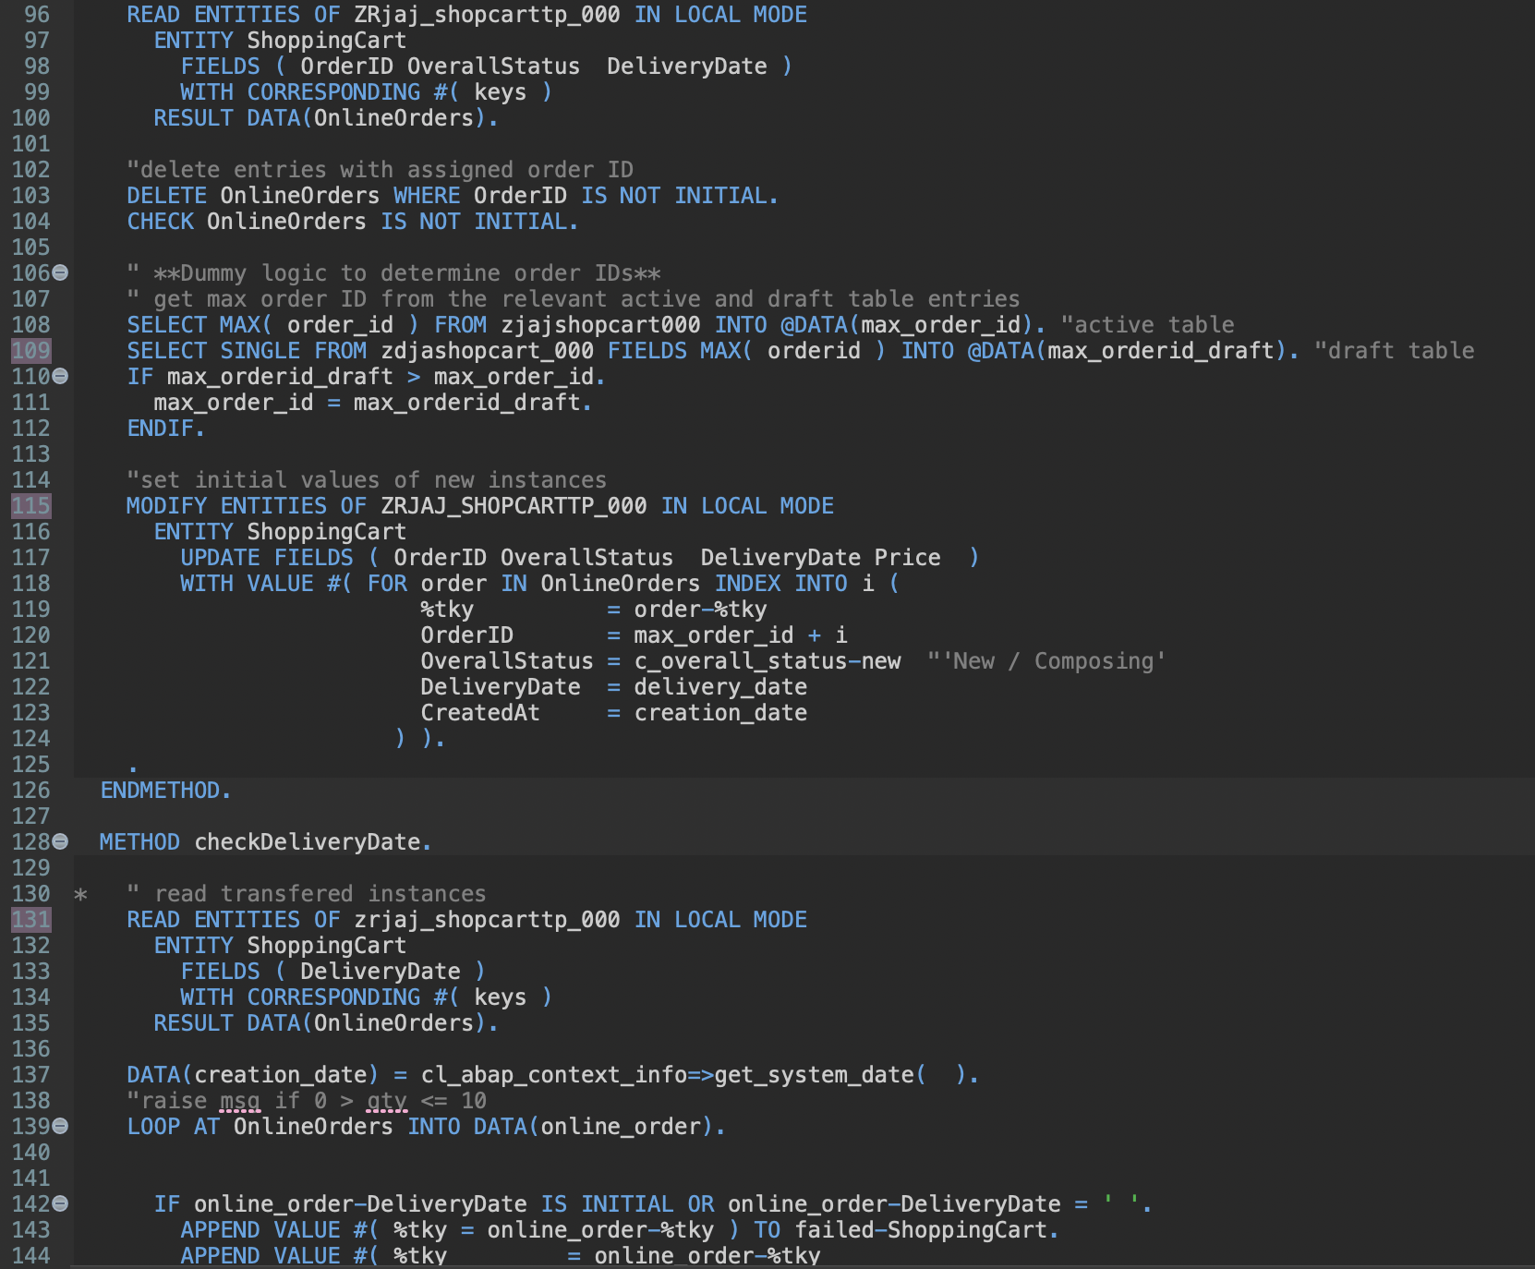
Enhance Behavior Implementation

Slide 20
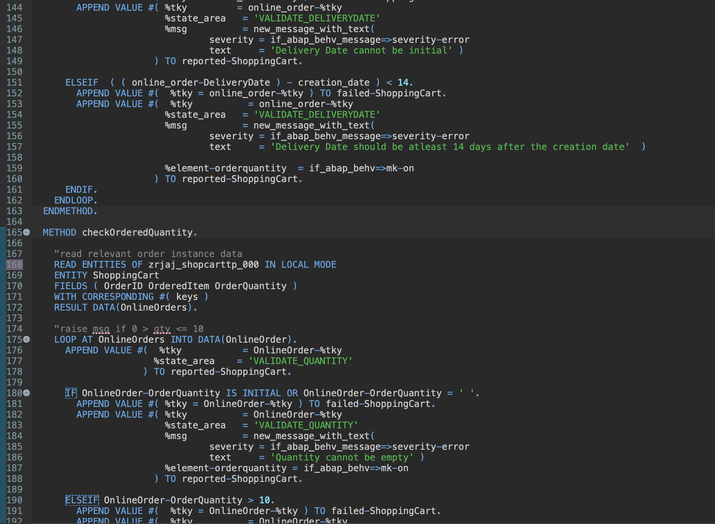
Enhance Behavior Implementation

Slide 21
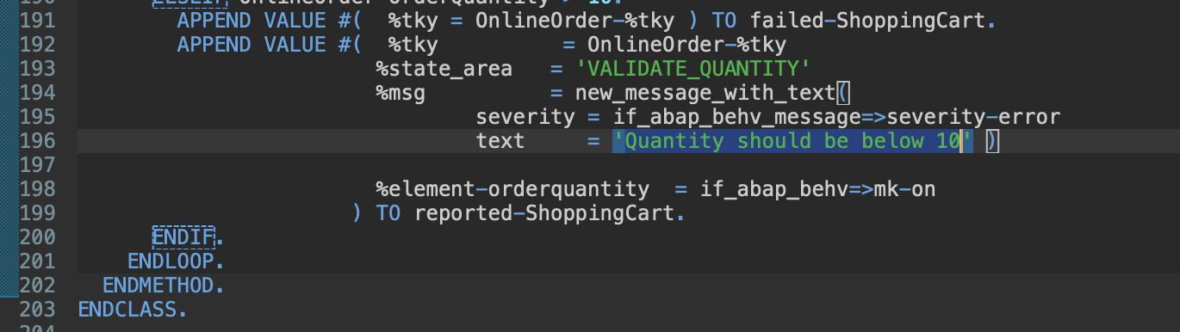
Enhance Behavior Implementation

Slide 22
Enhance behavior definition of data model
Add the following...

Slide 23
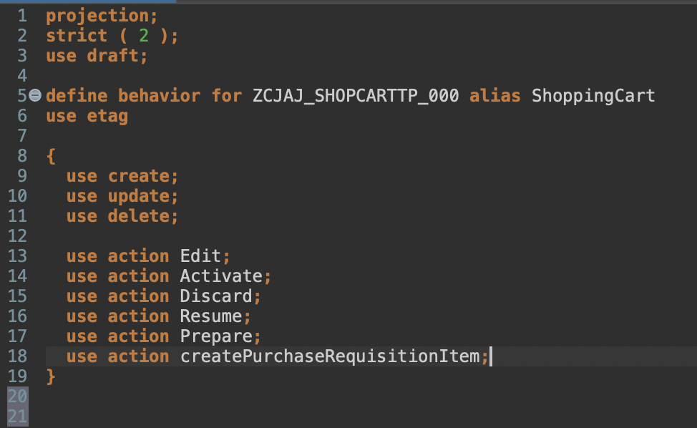
Enhance behavior definition of projection view

Slide 24
Enhance metadata extension

Slide 25
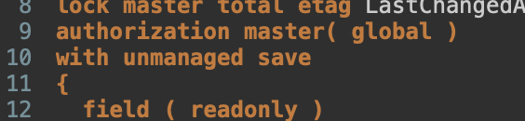
Implement unmanaged save and save_modified
Delete the line with persistent table zjajashopcart000 and insert with unmanaged save in your behavior definition.

Slide 26
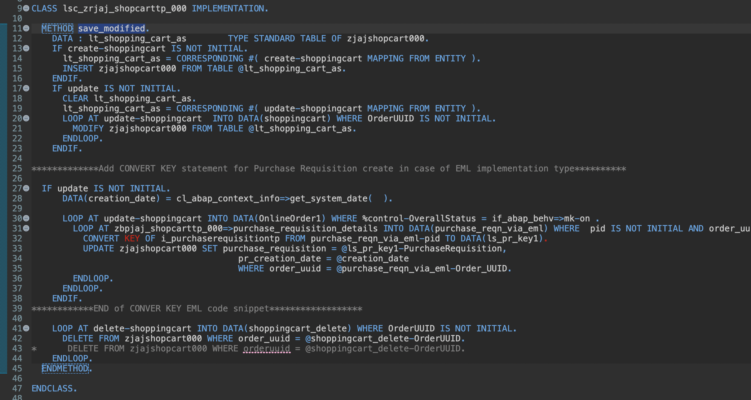
Implement the save modified method
Don‘t save and activate.

Slide 27
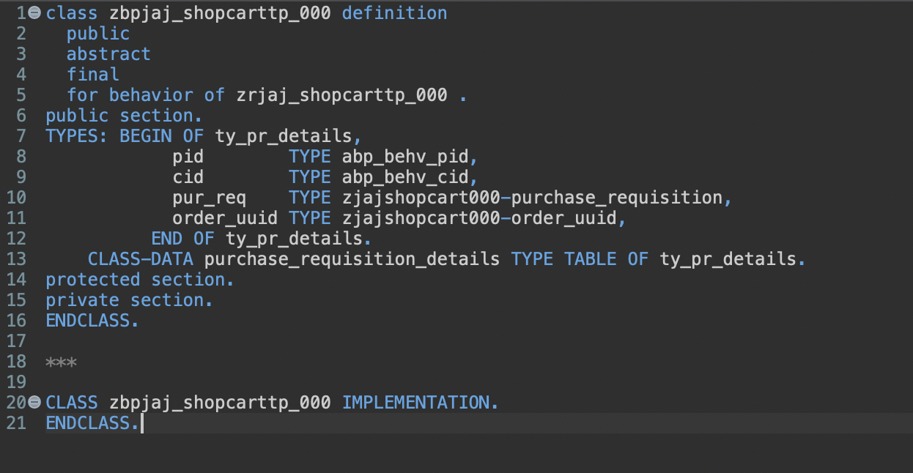
Implement global class
Save and activate.

Slide 28
Enhance behavior implementation
Add the missing constant to your implementation, the createPurchaseRequisitionItem action and enhance the save_modified method.
Tipp: replace the code with the sample data and only change names.

